Slide 1

Cyber Security
Lecture # 06

Slide 2
Lecture Overview
OSI Seven layers Model
Application Layer
Presentation Layer
Session Layer
Transport Layer
Network Layer
Data Link Layer
Physical Layer

Slide 3
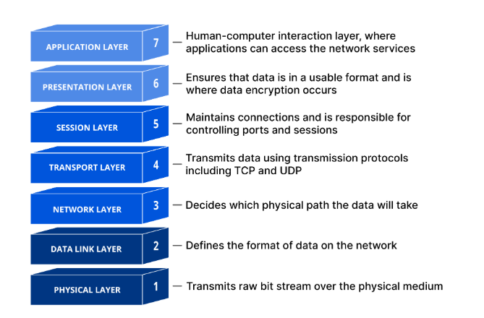
Open Systems Interconnection Model (OSI) MODEL

Slide 4
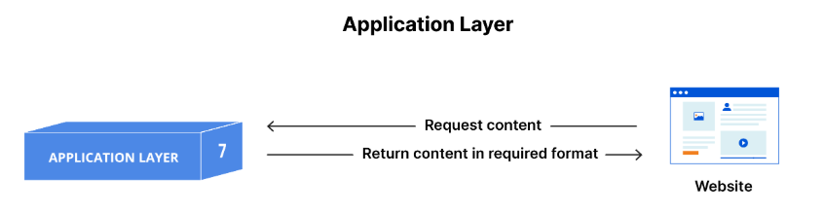
This is the only layer that directly interacts with data from the user.
Application layer protocols include HTTP as well as SMTP (Simple Mail Transfer Protocol is one of the protocols that enables email communications).

Slide 5
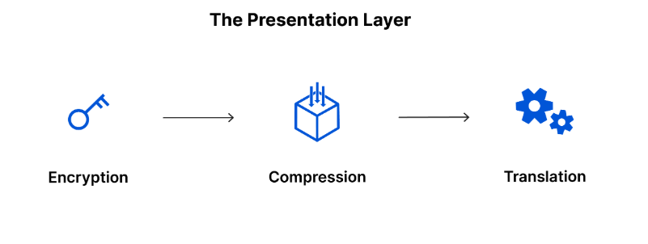
The presentation layer is responsible for translation, encryption, and compression of data.
Layer 6 is responsible for translating incoming data into a syntax that the application layer of the receiving device can understand.
The presentation layer is also responsible for compressing data it receives from the application layer before delivering it to layer 5.

Slide 6
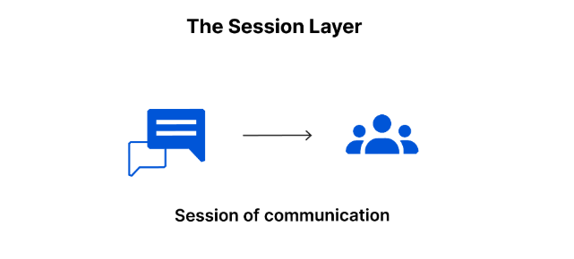
This is the layer responsible for opening and closing communication between the two devices.
The time between when the communication is opened and closed is known as the session.
The session layer ensures that the session stays open long enough to transfer all the data being exchanged, and then promptly closes the session in order to avoid wasting resources.

Slide 7
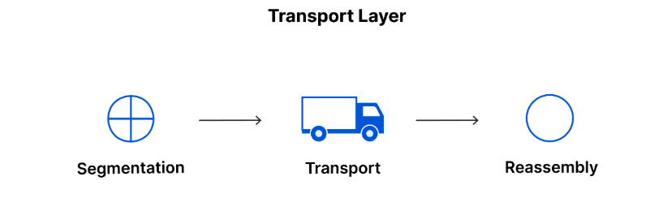
Layer 4 is responsible for end-to-end communication between the two devices.
This includes taking data from the session layer and breaking it up into chunks called segments before sending it to layer 3.
The transport layer on the receiving device is responsible for reassembling the segments into data the session layer can consume.
Transport layer protocols include the Transmission Control Protocol (TCP) and the User Datagram Protocol (UDP).

Slide 8
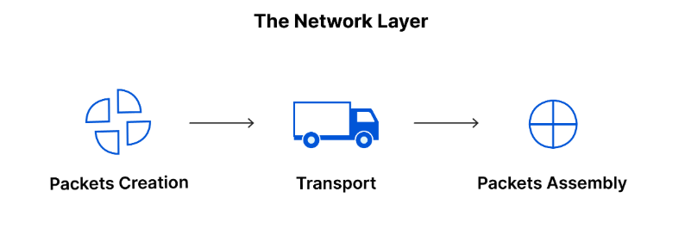
The network layer is responsible for facilitating data transfer between two different networks.
The network layer breaks up segments from the transport layer into smaller units, called packets.
Fragmentation occurs in it.
Network layer protocols include IP, the Internet Control Message Protocol (ICMP), the Internet Group Message Protocol (IGMP), and the IPsec suite.

Slide 9
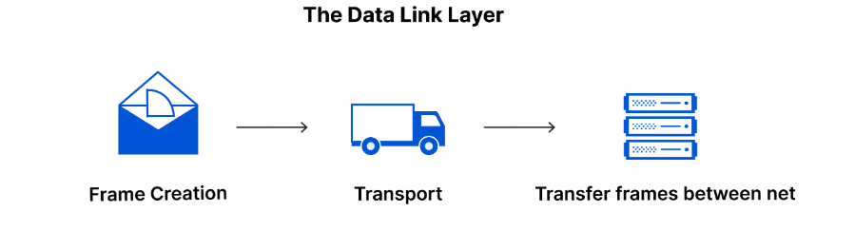
The data link layer takes packets from the network layer and breaks them into smaller pieces called frames.
Like the network layer, the data link layer is also responsible for flow control and error control in intra-network communication (The transport layer only does flow control and error control for inter-network communications).

Slide 10
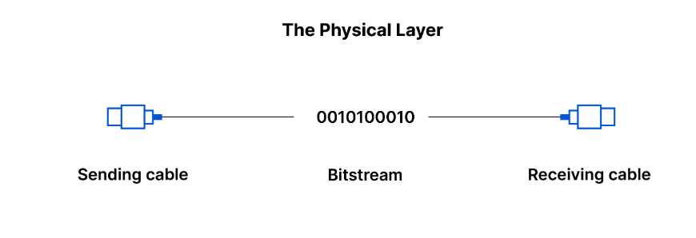
This layer includes the physical equipment involved in the data transfer, such as the cables and switches.
This is also the layer where the data gets converted into a bit stream, which is a string of 1s and 0s.
The physical layer of both devices must also agree on a signal convention so that the 1s can be distinguished from the 0s on both devices.

Slide 11
CLOUD COMPUTING
According to the National Institute of Standards and Technology (NIST):
“Cloud computing is a model for enabling convenient, on-demand network access to a shared pool of configurable computing resources (e.g., networks, servers, storage, applications, and services) that can be rapidly provisioned and released with minimal management effort or service provider interaction.”
Cloud computing means using the internet to access shared computer resources like servers, storage, and software whenever needed, without managing the physical hardware.
The NIST Definition of Cloud Computing - Content Details -

Slide 12
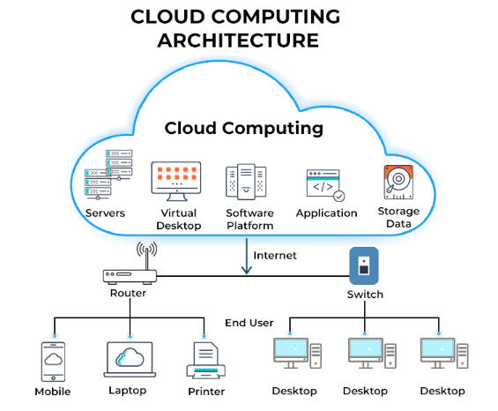

Slide 13
Types of Cloud Deployment Models
There are three primary classifications of clouds:
Public clouds offer their infrastructure or services to the general public or a large industry group.
Example: Amazon Web Services (AWS), Google Cloud Platform (GCP), Microsoft Azure
2. Private clouds are clouds used specifically by a single organization without offering the services to an outside party.
Example: A bank or university hosting its own private servers for security reasons

Slide 14
3. Hybrid clouds, which combine the elements of private and public clouds. Hybrid clouds are essentially private clouds that have some limited public access.
Example: Netflix uses AWS (public) for streaming and its own private cloud for sensitive data
4. Community clouds are midway between private and public clouds. They are systems wherein several organizations share a cloud for specific community needs.
Example: Healthcare organizations sharing a cloud for patient data, or universities collaborating on research
Hybrid = one organization using two types of clouds (private + public).
Community = multiple organizations sharing one cloud for a common purpose.

Slide 15
Cloud Model Services
Infrastructure as a Service (IaaS) – Offers virtual servers, storage, and networking resources.
Platform as a Service (PaaS) – Provides tools and environments to build, test, and deploy applications.
Software as a Service (SaaS) – Use software online without installing it on your computer.
Other Specialized Services –
DaaS: Desktop as a Service
ITMaaS: IT Management as a Service
MBaaS: Mobile Backend as a Service
SECaaS: Security as a Service

Slide 16
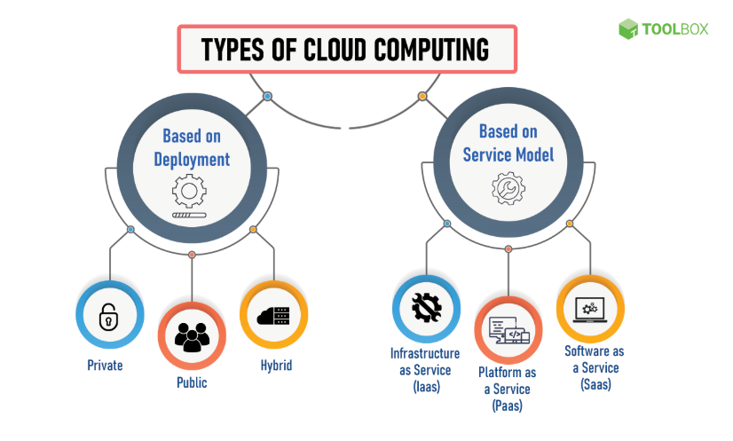

Slide 17
Thank you!
“Security is not a product, but a process”

